Slide 1
Data Ingest
Carsten Hufe Senior Data Engineer
17. October 2017

Slide 2
Agenda
MapR cluster
Sources and destinations for data ingest
Tools for data ingest
ETL example
Ingest from DB and files
Posix / FUSE
Data Placement

Slide 3
MapR cluster

Slide 4

Customers Do-It-Yourself
APACHE HADOOP AND OSS ECOSYSTEM
Not pre-integrated
More expensive
Latencies everywhere
Unreliability grows
Batch
ML, Graph
SQL
NoSQL & Search
Streaming
Data Integration
& Access
Security
Workflow
& Data Governance
Provisioning
&
coordination
Tez
Spark
Drill
Cascading
GraphX
Spark SQL
Hue
Pig
MLLib
Impala
Solr
Storm
HttpFS
Savannah
MapReduce v1 & v2
Mahout
Hive
HBase
Spark Streaming
Flume
Kafka cluster
Juju
YARN
Sqoop
Sentry
Oozie
ZooKeeper
EXECUTION ENGINES
DATA GOVERNANCE AND OPERATIONS
HA duplicate
Search cluster
NAS storage
NoSQL cluster

Slide 5













Evolution of the MapR Converged Platform
Data in Motion Meets Data At Rest
Apps
Data Architecture Optimization
Customer Experience
Security Investigation & Event Management
Operational Intelligence
Managed Services & Custom Apps
MapR Converged Data Platform
Cloud & Managed Services
Custom Apps
Processing
Search
Open Source Engines & Tools
Enterprise Engines & Applications
File/Storage
Database
Streaming
MapR-FS
MapR-DB
MapR Streams
Data
Global High Availability
Global Namespace
Data Protection & Unified Security
Real time
Multi-tenancy
Management & Monitoring
MapR Data Services

Slide 6
Open Source by design
APACHE HADOOP AND OSS ECOSYSTEM
Batch
ML, Graph
SQL
NoSQL & Search
Streaming
Data Integration
& Access
Security
Provisioning
&
Coordination
Workflow
& Data Governance
Spark
Drill*
Cascading
GraphX
SparkSQL
Hue
Savannah*
Pig
MLLib
Impala
Solr
Storm*
HttpFS
Juju
MapReduce v1 & v2
Mahout
Hive
HBase
Spark Streaming
Flume
Knox*
Falcon*
Whirr
MapR Control System
(Management and Monitoring)
YARN
Sqoop
Sentry*
Oozie
ZooKeeper
EXECUTION ENGINES
DATA GOVERNANCE AND OPERATIONS
NFS
HDFS API
HBase API
JSON API
MapR-FS
(POSIX)
MapR-DB
(High-Performance NoSQL)
MapR Data Platform
(Random Read/Write)

Slide 7











Data Exploration
OLTP, ERP, CRM
Documents
CSV
Text Files
Social Media
Clickstream
ETL Processing (MapReduce, Spark, Pig)
Interactive Query Engine
(Drill)
Business Intelligence
NFS
MapR-FS
MapR-DB
MapR Streams
Data Exploration
Analytics
MapR Data Platform
Converged Data Platform
Reporting
Offload / Reload
Data Marts
Data Warehouses

Slide 8
Data Sources

Slide 9
Data Sources
Files from other storages
Databases like Oracle, MySQL, MongoDB, Cassandra
Applications calling external interfaces, e.g. REST
Sensors
External streams like Kafka
Socia Media
Clickstreams
Notes:
This normalization of access can be emphasized for hadoop users.

Slide 10
MapR Components for Data Ingest

Slide 11
MapR Components and Tools
MapR-Streams
MapR-DB
MapR-FS using Java API or Hadoop fs command
NFS / Fuse / POSIX
HttpFS
Sqoop
Flume
Notes:
This normalization of access can be emphasized for hadoop users.

Slide 12
Data Ingestion is key to a Converged Platform
Databases
Sqoop
Custom Connectors
(e.g. Teradata Connector)
Log data
(w/ light transformation)
Flume
MapR Streams
High volume
raw data
ingestion
NFS
POSIX Client

Slide 13
POSIX Client Use cases
HPC deployments
HPC deployments require high performance access to data stored in MapR Platform. HPC Applications - often written in C/C++ without HDFS APIs – can now read/write data without changing a single line of code.
Cloud Providers
Cloud providers that provide Hadoop as a service can also use Hadoop as a store for tenant data. Launching client/tenant cloud instances with MapR POSIX Client provides access to the tenant data instantly and securely.
Ingesting logs from Web Servers/Application Servers
MapR POSIX Client allows every web server to directly write to the MapR cluster. To all local applications, the logs still appear local, but are actually ingested into the cluster in real-time. This can then be combined with other real-time technologies from MapR like Spark streaming to create real-time analytics feedback systems.

Slide 14



MapR POSIX Client: Secure Faster Native Access
CLIENT NODE(S)
MapR data access options:
HDFS API – requires recoding existing apps
Standard read/write NFS – no client installation
MapR POSIX Client – high speed read/write NFS plus:
Authentication
Encryption
Compression
Parallelism
Hadoop applications (e.g. “hadoop fs –put”)
File-based apps/utils (e.g. cp, emacs)
Native applications
1
2
HDFS API (hadoop-core-*.jar)
NFS client (included in OS)
NFS client (included in OS)
3
MapR POSIX Client
New!
NFS Gateway
NFS Gateway
NFS Gateway
Redundant gateways for high availability
MapR cluster

Slide 15
MapR POSIX Client: Multiple cluster access
CLIENT NODE(S)
POSIX Client can work with multiple clusters simultaneously unifying namespace and easing universal data access
Hadoop applications (e.g. “hadoop fs –put”)
File-based apps/utils (e.g. cp, emacs)
Native applications
1
2
HDFS API (hadoop-core-*.jar)
NFS client (included in OS)
NFS client (included in OS)
3
MapR POSIX Client
NFS Gateway
NFS Gateway
NFS Gateway
Redundant gateways for high availability
MapR cluster
MapR cluster
MapR cluster

Slide 16
More options to connect to MapR
 | Hadoop style | NFS Gateway | POSIX Client
Existing Apps | Rewrite to HDFS API. | No rewrite required. | No rewrite required.
Client Slide Work | Install mapr-client on client node | Mount cluster on client node. | Install POSIX client on client node.
Client – Cluster Compression | Yes | No | Yes
Secure | Yes (per user) | No (full access) | Yes (per machine) → per user(roadmap)
Performance | High | High | Very High
Client – Cluster Parallelized | Yes | No | Yes
Term | Included | Per node (Part of cluster) | Per client

Slide 17
3rd Party Tools for Data Ingest

Slide 18
3rd party tools could be …
Notes:
This normalization of access can be emphasized for hadoop users.

Slide 19
ETL example

Slide 20
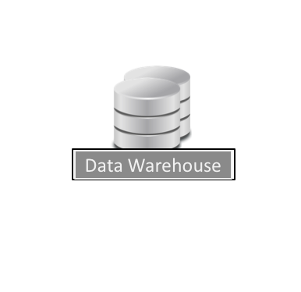

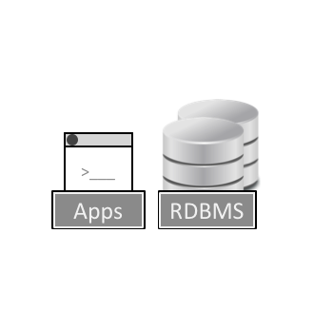
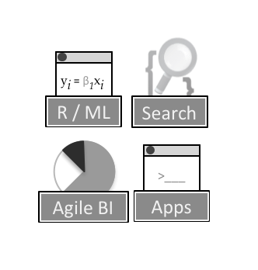
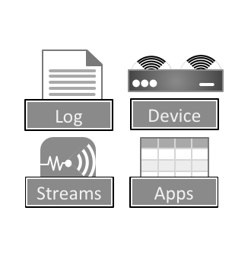

ETL Approach is Jaded
Data Sources
Data Stores
Data Consumers
Past (ETL)
Fixed schema ETL for Data warehouses
Source Data structured and rigid transaction data
ETL
ETL
Emerging (Ingest)
Explosion of Data Stores – fluid infrastructure
Source Data predominantly multi-structured interaction data
Data Drift: Structure, Semantic, Infrastructure
MapR Data Platform
Ingest
Analyze
Notes:
History is repeating itself
Past: 70% of data warehouse projects used to fail. Fixed-schema ETL technology came along and automated what was previously a manual and brittle task.
Future: Explosion of Big Data apps, tools and techniques. Tied to specific data stores (fluid & multiplying). Inherent schema-centricity of legacy ETL tools prevent them from being used in the extracting and loading (now called ingest) of semi-structured data. Organizations have resorted to manually-coded data ingest pipelines. Manually-coded pipelines are unsustainable, but more importantly fail due to drift.

Slide 21
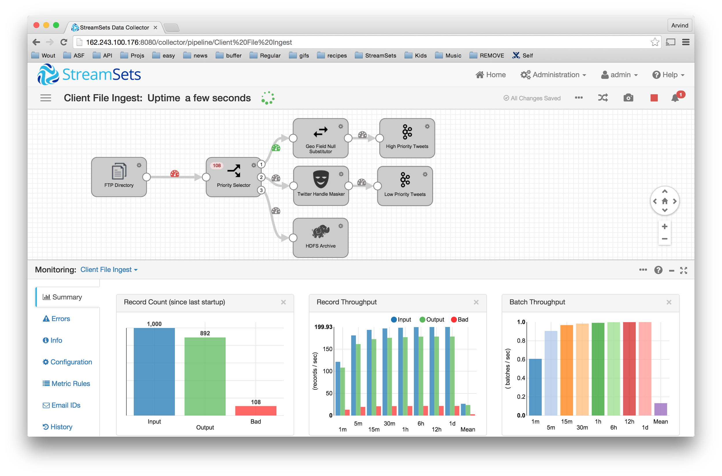
Product:
StreamSets Data Collector
Adaptable Pipelines for Efficiency
Intent Driven Flows
Batch & Real Time
On Edge & In Cluster Sanitization
Data KPIs for Control
Stage & Flow Metrics
Drift Handling & Alerts
Metadata & Data Lineage Capture
Containerized Architecture for Agility
Snapshot & Replay
Seamless Iterations & Upgrades
Embed, Extend, Integrate
Notes:
StreamSets Data Collector – open source software for building and running data pipelines that accelerates time to analysis
Efficiency –a visual IDE to easily connect sources to destinations--light on schema specification, batch & streaming, on edge and in cluster
Agility – data exception handling, data flow evolution, data infrastructure modernization with minimal down time
Control – built-in data cleansing plus ability to adapt to data drift improves downstream data quality; monitor and alert on data KPI’s in real-time.

Slide 22
Ingest from DB
and Files

Slide 23

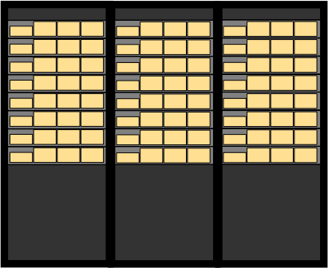
Getting Data onto a Cluster
Example: mining web logs for meaningful data
First: get the logs into the cluster
Do you have to break logs into small pieces to allow frequent batches?
How soon after writing to a log are results available?
Do you have to concatenate these files together later?
How many files do you wind up with?
hadoop fs –put, copyfromlocal
distcp
Flume/Sqoop/CDC

Slide 24

Using Data on Cluster
Once data is stored on the Hadoop cluster, these are your tools to access and use the results of processing data
copytolocal
hadoop fs

Slide 25
With MapR-FS You Can Use POSIX
With MapR, you can use NFS/FUSE to access results on your cluster
Access all of the data in your cluster with standard applications
Web-server for web applications
Double-click a file (spreadsheet, report, etc.)
edit, save, etc.
Run a Python script
grep, sed, awk, shell scripts, etc.
This includes using legacy applications such as databases
A file in MapR-FS can be an external table for MySQL or Oracle
Notes:
This normalization of access can be emphasized for hadoop users.

Slide 26
Handling Data with NFS in MapR
Mount your cluster filesystem locally
/mapr/my.cluster.com/myvolume/…
Redirect (or rsync) logs to cluster
Use Hadoop jobs or standard Linux commands to work with your MapR-FS files
log data
Notes:
Drag and drop
Open files and apps
Watch live data come in
Fully read/write
Multiple concurrent reads/writes
Easy to get data in/out
Same namespace paths as Hadoop
Mount with
-o tcp,ver=3,nolock
Mount a cluster like a disk!

Slide 27
Posix / FUSE

Slide 28
NFS and FUSE Access
MapR data access options:
HDFS API – requires recoding existing apps
Standard read/write NFS – no client installation
VIPs for automatic failover
DNS round robin for load spreading
MapR FUSE POSIX Client – high speed read/write plus:
Parallelism
Compression
MapR Native Security [optional]
Authentication
Encryption
CLIENT NODE(S)
Hadoop applications (e.g. “hadoop fs –put”)
File-based apps/utils (e.g. cp, emacs)
Native applications
1
2
HDFS API (hadoop-core-*.jar)
NFS client (included in OS)
FUSE (included in OS)
3
MapR FUSE POSIX Client
New!
NFS Gateway
NFS Gateway
NFS Gateway
Redundant gateways for high availability
* MapR also supports an NFS based POSIX client
MapR cluster

Slide 29
MapR Fuse Client on Application Servers
Application Server
Loopback Mount:
localhost:/mapr /mapr
Linux Fuse Client
Mapr-loopback
Translate File system
into API Calls
Mapr client API
Network Security :
MapR RPC Full Wire Encryption
Client -> Server Communication
Server -> Server Communication
MapR Inline Compression
Supported Compression algorithms ( per Directory )
LZ4, LZF, ZLIB
Network Traffic will be compressed automatically
1
2
3
4
5
MapR RPC
MapR RPC
MapR RPC
MapR RPC
MapR RPC
Chunk 1
256MB
1
Chunk 2
256MB
2
Chunk 3
256MB
3
Chunk 4
256MB
4
Chunk 5
256MB
5
mapr-fileserver
S1
mapr-fileserver
S2
mapr-fileserver
S3
mapr-fileserver
S4
mapr-fileserver
S5
1
1
1
2
2
5
5
2
3
3
3
5
4
4
4
MapR Data Platform

Slide 30
Data placement

Slide 31
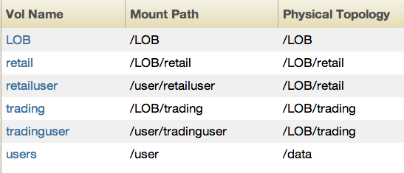
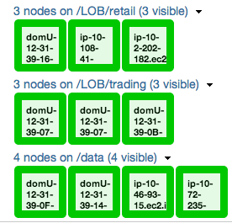
Data Placement
Topology: grouping of nodes
Align Volumes => Topology for Data Isolation

Slide 32
Label based scheduling + JobQueue ACLs
Nodes can be assigned a label
Users can be assigned to a Queue
Labels can be assigned to a Queue
Labels+Queues ensure CPU/RAM isolation
Retail label
Retail Queue
node2
node3
node4
root
mapr
retailusers
Trading label
Trading Queue
node4
node5
node6
root
mapr
tradingusers
Default label
Default Queue
node7
node8
node9
node10
root
mapr

Slide 33
Hands-On

Slide 34
DB Schema

Slide 35



Questions?
Q&A
Carsten Hufe
Senior Data Engineer
chufe@mapr.com

